Slide 1
Careseeker’s Blockchain
Avinash Kumar Gupta
MBBS - 3rd Year

Slide 2

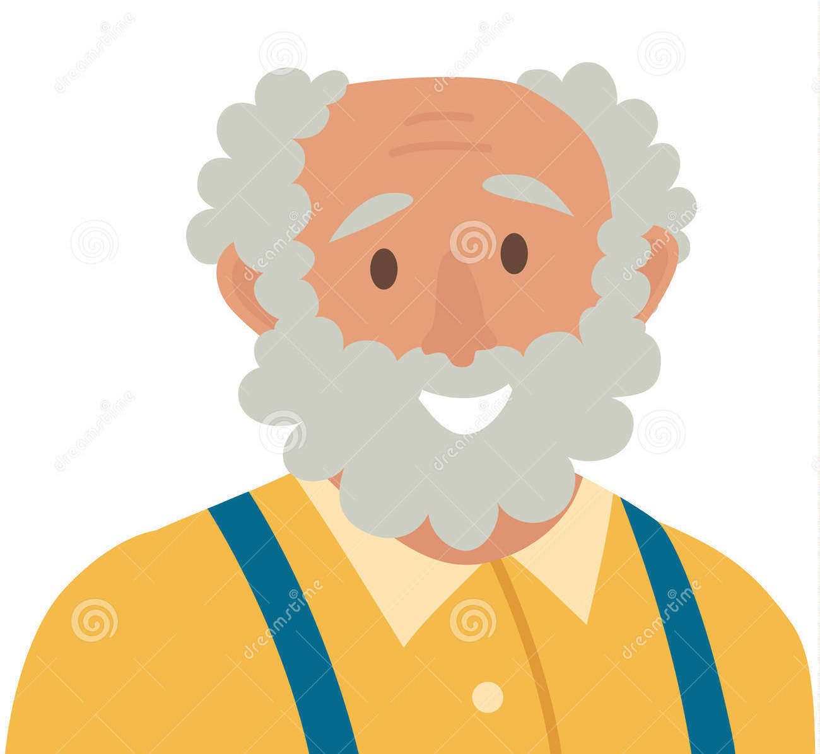
Wearables
Health Data
1 individual from Doctors, Students, nurses, or any medico from a care taking team.
Specialis
Doctor
Student
Nurse
Laboratory
Pharmacy
Medical Advice
EMRs
Health Data

Slide 3
Best Use Case
ICU - To keep realtime update of ICU device and test values and have access by consultant 24*7 with custom notification on any emergency value and direct connection option with working nurse
Home Care - Specially for poor or rural communities can share data in secqure way and get help for their patient’s
Qantised Self - to store all data from wearables and have visualization and feedback rather than losing them.
Research - All data after patient’s consent can be used to research and find out more about medical science.

Slide 4
Private blockchain consortium with minimum 2 parties
Private blockchain between patient and many stakeholders in healthcare, like students, doctors, nurses, academics, scientist, etc.
Patient data and medicos advice (and discussion as a team) will be done with smart contracts to verify & update in secure way as TRUST is important in any medical advice.

Slide 5
IOT
Secure data transaction , verification and analysis to prevent any emergency like patient falling down, fainting, heart attack, etc. and use this as a standard by providing API for device makers.
Data have to be used by 1) doctors 2) Ai
Data will be owned by patient and will be accessible to caregivers when patient shares keys.
Data storage on private blockchain
Mining ( verifying transactions ) will generate revenue and medicos will be paid from that to give care.

Slide 6
Gamification
Gamification provides credits which are distributed based on addition of following 3 criteria.
Academic Skills ( Nurse/MBBS/DM)
Impact credits ( if more upvotes on evidence to solve medical complexity, more points)
Power UPs ( Power ups are provided based on high engagement with high impact, where measure of impact will be directly proportional to level of academic skills)

Slide 7
Example Transactions ( Smart Contracts)
A medical student studies the case and solve questions in PICO format by finding evidences from books and research articles
A device tracks exercise and logs it along with vitals
A doctor explore the data and advice an exercise
A patient real-time data accessed by AI and emergency calls in case of any mishap.

Slide 8
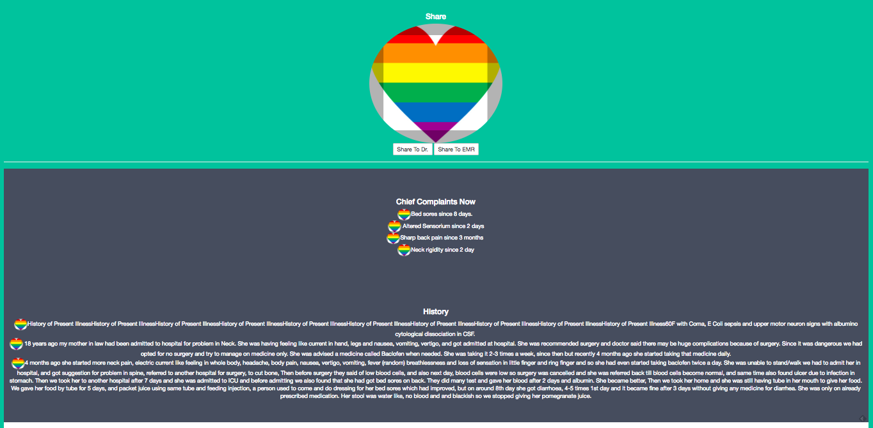

Slide 9
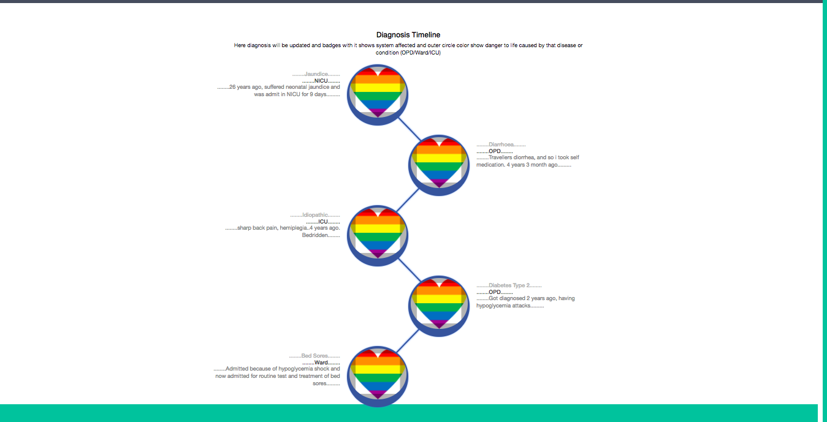

Slide 10
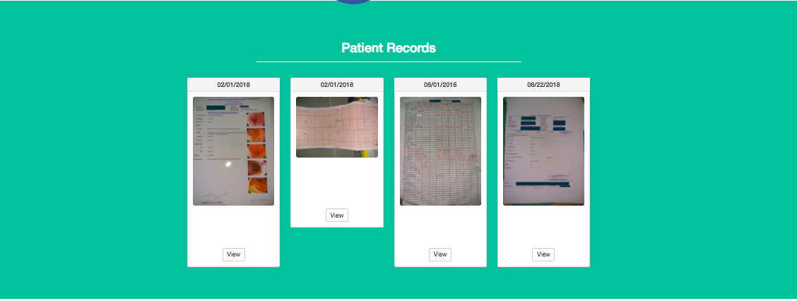

Slide 11
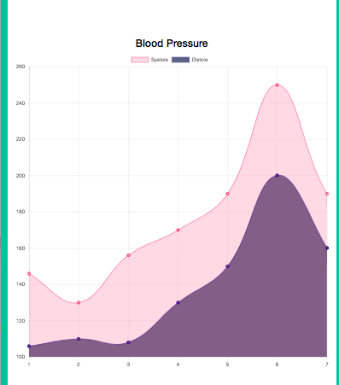

Slide 12
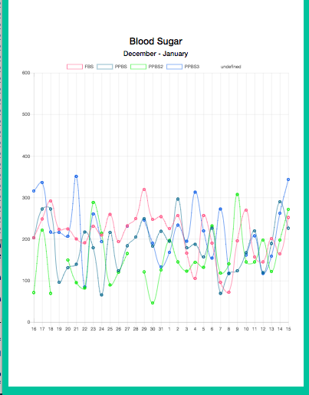
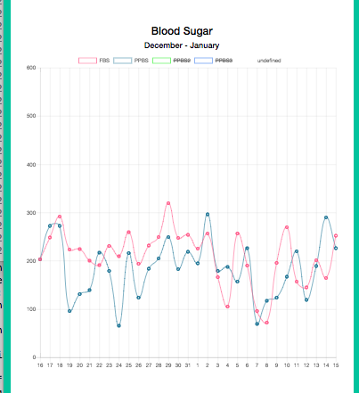

Slide 13
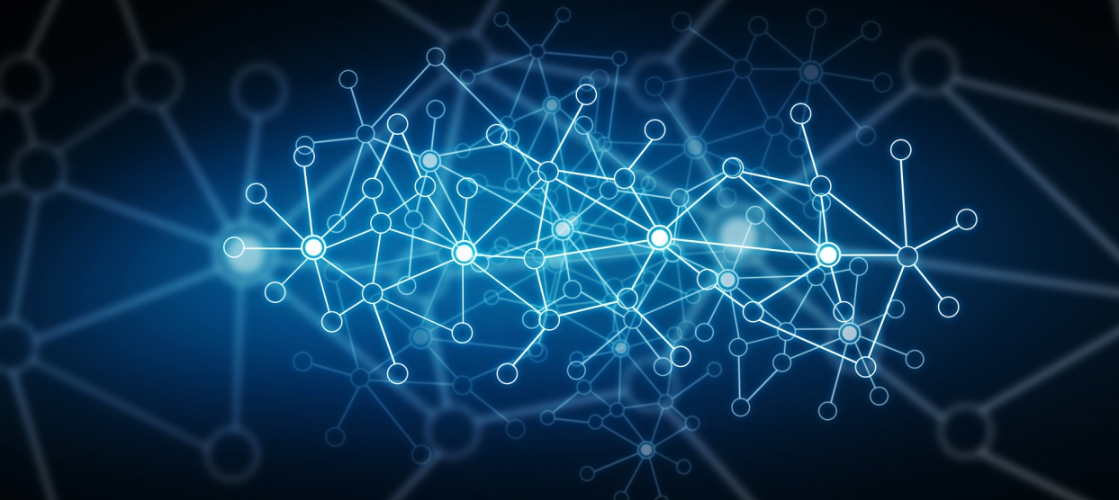
Thank you.

